Slide 1
IP Datagrams and Datagram Forwarding
COSC350

Slide 2
Introduction
Fundamental Internet communication service
Format of packets
Processing of packets by routers
Forwarding
Delivery

Slide 3
Connectionless service
End-to-end delivery service is connectionless
Extension of LAN abstraction
Universal addressing
Data delivered in packets (frames), each with a header
Combines collection of physical networks into single, virtual network
Transport protocols use this connectionless service to provide connectionless data delivery (UDP) and connection-oriented data delivery (TCP)

Slide 4
Virtual packets
Packets serve same purpose in internet as frames on LAN
Each has a header
Routers (formerly gateways) forward between physical networks
Packets have a uniform, hardware-independent format
Includes header and data
Can't use format from any particular hardware
Encapsulated in hardware frames for delivery across each physical network

Slide 5
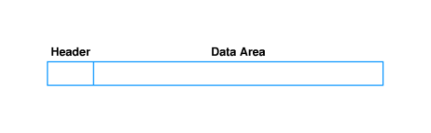
IP datagram format
Formally, the unit of IP data delivery is called a datagram
Includes header area and data area
Datagrams can have different sizes
Header area usually fixed (20 octets) but can have options
Data area can contain between 1 octet and 65,535 octets (2¹⁶ - 1)
Usually, data area much larger than header

Slide 6
Forwarding datagrams
Header contains all information needed to deliver datagram to destination computer
Destination address
Source address
Identifier
Other delivery information
Router examines header of each datagram and forwards datagram along path to destination

Slide 7

Routing example
Network A
Network E
Host 2
Network B
R1
R2
Host 3
Host 1
R3
R4
Host 5
Host 4
Network D
Network C

Slide 8
Routing table
For efficiency, information about forwarding is stored in a routing table
Initialized at system initialization
Must be updated as network topology changes
Contains list of destination networks and next hop for each destination

Slide 9
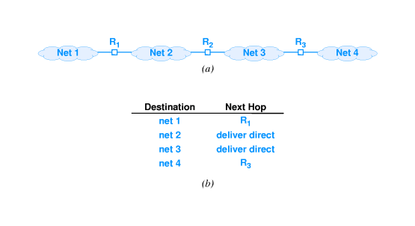
from R2

Slide 10
Default routes
Routing table kept small by listing destination networks rather than hosts
Can be further reduced through default route
Entry used if destination network not explicitly listed in routing table

Slide 11
Routing tables and address masks
In practice, additional information is kept in routing table
Destination stored as network address
Next hop stored as IP address of router
Address mask defines how many bits of address are in prefix
Prefix defines how much of address used to identify network
E.g., class A mask is 255.0.0.0
Used for subnetting

Slide 12
Address masks
To identify destination network, apply address mask to destination address and compare to network address in routing table
Can use Boolean and
if ((Mask[i] & D) == Dest[i]) forward to NextHop[i]
Consider a datagram with 192.4.10.3 as destination arrived at the center router :
First entry fails
Second and third entry fail
Last entry: 255.255.255.0 & 192.4.10.3 == 192.4.10.0
So the next hop would be 128.1.0.9

Slide 13
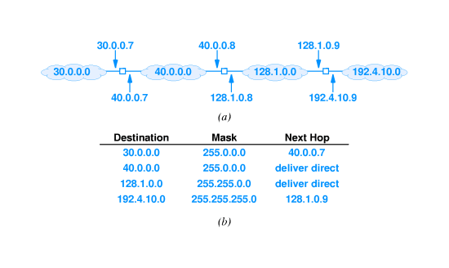
Next hop routing
Longest prefix match
There can be overlapping matches
Only the longest match will be used

Slide 14
Forwarding, destination address and next-hop
Destination address in IP datagram is always ultimate destination
Router looks up next-hop address and forwards datagram
Network interface layer takes two parameters:
IP datagram
Next-hop address
Next-hop address never appears in IP datagram

Slide 15
Best-effort delivery
IP provides service equivalent to LAN
Does not guarantee to prevent
Duplicate datagrams
Delayed or out-of-order delivery
Corruption of data
Datagram loss
Reliable delivery provided by transport layer
Network layer - IP - can detect and report errors without actually fixing them
Network layer focuses on datagram delivery
Application layer not interested in differentiating among delivery problems at intermediate routers

Slide 16
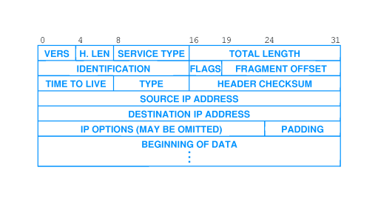
IP datagram header format

Slide 17
IP datagram header fields
VERS - version of IP (currently 4)
H. LEN - header length (in units of 32 bits)
SERVICE TYPE - sender's preference for low latency, high reliability (rarely used)
TOTAL LENGTH - total octets in datagram
IDENT, FLAGS, FRAGMENT OFFSET - used with fragmentation
TTL - time to live; decremented in each router; datagram discarded when TTL = 0
TYPE - type of protocol carried in datagram; e.g., TCP, UDP
HEADER CHECKSUM - 1s complement of 1s complement sum
SOURCE, DEST IP ADDRESS - IP addresses of original source and ultimate destination

Slide 18
IP datagram options
Several options can be added to IP header:
Record route
Source route
Timestamp
Header with no options has H. LEN field value 5; data begins immediately after DESTINATION IP ADDRESS
Options added between DESTINATION IP ADDRESS and data in multiples of 32 bits
Header with 96 bits of options has H. LEN field value 8

Slide 19
IP Encapsulation
In a physical network, frame is used to deliver IP datagram
The technique is called IP encapsulation

Slide 20
Encapsulation illustration

Slide 21
Transmission across an internet
Networks may use different technologies
Header format may be different
Each hardware technology specifies the maximum amount of data for a frame to carry (MTU)
Example: Ethernet MTU is 1500 octets
If the amount of data bigger than current MTU, fragmentation may occur - IDENTIFICATION field and OFFSET field are used to reassemble

Slide 22
IP fragmentation Flags Field
Bit Position | Field Name | Meaning
0 | Reserved | Always 0
1 | Don't Fragment (DF) | 1 = No fragmentation, 0 = Fragmentation allowed
2 | More Fragments (MF) | 1 = More fragments to follow, 0 = Last fragment

Slide 23
Transmission across an internet cont’
Consider a 1500-octet datagram sent from H1 to H2 in the following network
Datagram can reach router R but cannot traverse Net 2
pathMTU discovery: a standardized technique in computer networking for determining the maximum transmission unit (MTU) size on the network path between two Internet Protocol (IP) hosts, usually with the goal of avoiding IP fragmentation. If doesn’t fit, an ICMP message is sent to the sender – DF field must be set to 1.

Slide 24
MTU Summary Table
Technology | Typical MTU | Notes
Ethernet | 1500 bytes | 9000 bytes for Jumbo Frames
Wi-Fi (802.11) | 2304 bytes | Often uses Ethernet MTU due to encapsulation
LTE/5G | 1500 bytes | Smaller MTUs for encapsulation
IPv4 | Varies, 576 bytes | 576 bytes minimum; depends on link-layer technology
IPv6 | 1280 bytes | Minimum required by the standard
VXLAN | 1550–1600 bytes | Extra for encapsulation overhead
PPP | 1492 bytes | Common in DSL and VPN
Fibre Channel | 2112 bytes | Payload size
LoRaWAN (IoT) | 51–241 bytes | Limited by technology constraints
GRE | 1476 bytes | Allows for header overhead

Slide 25
Datagram Fragmentation
Technique for accommodating heterogeneous MTUs
Needed if datagram exceeds MTU
Original datagram divided into smaller datagrams called fragments
Header of fragment derived from original datagram header
Each fragment is forwarded independently
IPv4 requires sending host to perform fragmentation

Slide 26
Datagram Fragmentation cont’
Divide the payload into a series of datagrams

Slide 27
Datagram Fragmentation cont’
Datagram header contains fixed fields that control fragmentation
A bit in FLAGS field specifies whether given datagram is a fragment or complete datagram
An additional FLAGS bit specified whether the fragment carries the tail of the original datagram
OFFSET field specifies where the payload belongs in the original datagram

Slide 28
Collecting fragments
Destination collects incoming fragments
IDENTIFICATION field used to group related fragments
OFFSET field allows receiver to recreate the original payload
LAST FRAGMENT bit allows receiver to know when all fragments have arrived
If a fragment fails to arrive within a timeout period, entire datagram is discarded

Slide 29
Hardware and protocol addressing
Underlying network hardware
Only understands MAC addresses
Requires each outgoing frame to contain the MAC address of the next hop
IP forwarding
Deals only with IP addresses
Computes the IP address of the next hop
The IP address of the next hop must be translated to a MAC address before a frame can be sent

Slide 30
Address Resolution
Translates IP address to equivalent MAC address that the hardware address understands
IP address is said to be resolved
Restricted to a single physical network at a time
A MAC address is needed at each hop in the above example

Slide 31
An Example with MAC addresses
Request is broadcast to all computers
Only the intended recipient replies
Reply is sent unicast

Slide 32
Summary
Basic unit of delivery in TCP/IP is IP datagram
Routers use destination address in IP datagram header to determine next-hop
Forwarding information stored in routing table
IP datagram header has 40 octets of fixed field information and (possibly) options

